Slide 1
Tomato Leaf Disease Detection
Presented by -
Team 38 – AI EXPLORERS
Pranali Yangandul
Hritik Parbat
Maitrayee Khalasi
Yamini Saini
Yasaswini
Rutuja

Slide 2
Introduction
Tomato plants are essential for agricultural production, providing a valuable source of nutrition and economic income.
However, they are vulnerable to various diseases caused by bacteria, fungi, and viruses.
These diseases can cause significant losses in yield and quality if not detected and managed promptly.

Slide 3
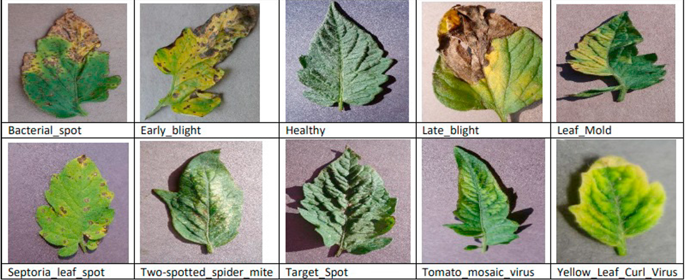
Tomato Plant Diseases
Early Blight: Causes, Symptoms, and Effects on Tomato Plants
Late Blight: Causes, Symptoms, and Effects on Tomato Plants
Bacterial Spot: Causes, Symptoms, and Effects on Tomato Plants etc..

Slide 4
CNN
Convolutional Neural Networks (CNNs) are a type of deep learning model specifically designed for image recognition tasks. They are inspired by the human visual system, where the brain processes visual information in a hierarchical manner.
Why CNNs for Image Recognition?
CNNs are powerful feature extractors, automatically learning meaningful patterns from images without requiring manual feature engineering.
Their hierarchical architecture allows them to capture low-level features (e.g., edges, textures) in early layers and high-level features (e.g., shapes, objects) in deeper layers.
CNNs have achieved state-of-the-art results in various computer vision tasks, including image classification, object detection, and segmentation.
For Tomato Plant Disease Detection, CNNs can analyze images of healthy and diseased tomatoes, identifying distinct patterns and making accurate predictions about the presence of diseases. By leveraging the capabilities of CNNs, we can efficiently detect diseases at an early stage, contributing to better crop management and increased agricultural productivity.

Slide 5
Steps
Data Collection: We collected a diverse dataset of images containing both healthy and diseased tomato plants from kaggle.
Data Preprocessing: Preprocessing steps may include resizing images to a uniform size, normalizing pixel values,
Feature Extraction:The convolutional layers in the CNN automatically learn and extract relevant features from the input images during training. This feature extraction process allows the model to recognize patterns and distinguish between healthy and diseased tomato plants.
Model Training: Using CNN: Train the CNN model using the preprocessed dataset. During training, the model learns to adjust its internal parameters (weights and biases) to minimize the classification error. The objective is to accurately classify tomato plant images into the respective disease categories or the "healthy" class.
Model Evaluation: After training, evaluate the performance of the CNN model on a separate validation dataset. The evaluation metrics include accuracy, precision, recall, F1-score, and confusion matrix.
Prediction and Deployment: Once the CNN model is trained and evaluated, it is ready for deployment. The model can be deployed as a standalone application, integrated into an agricultural system, or used in conjunction with IoT devices to facilitate real-time disease detection on farms.

Slide 6
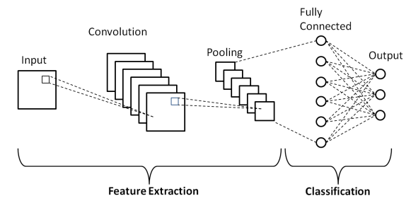
Model Architecture

Slide 7
In the diagram:
The "Input (Image)" represents the original image with dimensions "Width x Height x Channels."
The "Convolutional Layers" consist of multiple convolutional filters with a specified depth and number of filters. They extract local features from the input image.
The "ReLU Activation" applies the Rectified Linear Unit activation function element-wise to introduce non-linearity.
The "Max-Pooling Layers" perform downsampling on the feature maps to retain essential information while reducing spatial dimensions.
The "Fully Connected Layers" process the flattened output of the previous layers.
The "Softmax Activation" calculates class probabilities for multi-class classification.
The "Output (Class Probabilities)" shows the probabilities for each class (e.g., different tomato plant diseases and "healthy" class) after applying softmax activation.

Slide 8
Future Scope
Future scopes and potential benefits for farmers in the context of Tomato Plant Disease Detection using CNN:
Early Disease Detection: With an accurate CNN-based disease detection system, farmers can identify diseases at an early stage even before visible symptoms appear. Early detection allows farmers to take timely and targeted actions, such as applying appropriate fungicides or adopting preventive measures, minimizing crop damage, and preventing disease spread.
Increased Crop Yield and Quality: By detecting and managing diseases promptly, farmers can mitigate the negative effects of diseases on crop yield and quality. Healthy plants lead to higher productivity and better-quality produce, resulting in increased profits.
Forecasting and Disease Trends: Leveraging historical data and CNN models, farmers can predict disease outbreaks and trends. This forecasting capability allows them to proactively prepare for potential disease threats and implement preventive measures accordingly.

